Slide 1
Spectral/hp element discretisation

Slide 2
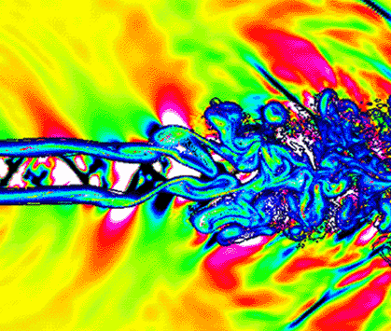
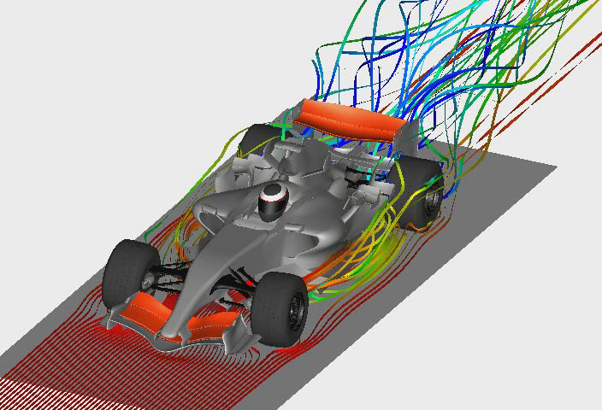
Spectral/hp elements
spectral
methods
j
uδ ={
i
h
uδ ={
p
finite difference method
Spectral/hp methods
finite element/finite volume
uδ ={
h

Slide 3
Spectral/hp elements
hp finite element - hierarchical
Spectral element method - nodal
Continuous Galerkin
Discontinuous Galerkin
Flux Reconstruction
Spectral Difference
….
Depends on how we bolt elements together!
h-type geometric
flexibility
p-type exponential
accuracy
Computational cost ~ P⁴
Computational error ~ h^{P}

Slide 4
P accuracy
Exact solution
Nel=128, P=1
Dof = 384
Nel=32, P=3
Nel=8, P=8
Dof = 192
Dof = 288
Bolis, Cantwell, Kirby, Sherwin Int J Num Meth. fluid, 2014
Notes:
Do I need to cover this or will have joaquim

