Slide 1
Nektar++ Framework
Structure

Slide 2
Framework design
ADR
IncNavierStokes
CompressibleFlow
PulseWave
ShallowWater
CardiacEP
…
SolverUtils
Core Nektar++ libraries
StdRegions
SpatialDomains
LocalRegions
MultiRegions
Collections
MatrixFreeOps
GlobalMapping
NekMesh
FieldUtils
LibUtilities
Quadrature, bases, partitioning, input/output, linear algebra, interpreter, FFT, ...
Boost
Scotch
TinyXML
Gslib
FFTW
VTK
PETSc
ARPACK
Metis
~/nektar

Slide 3
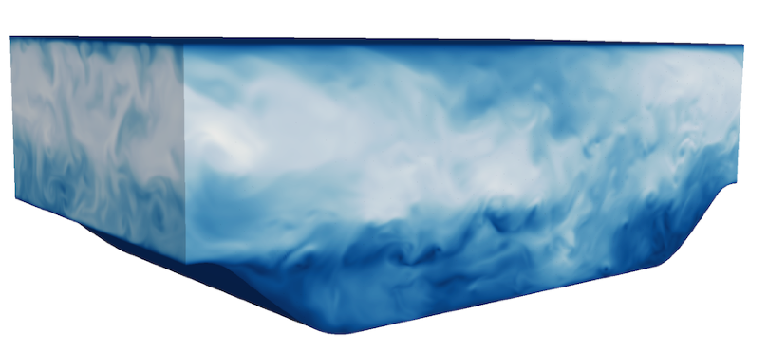
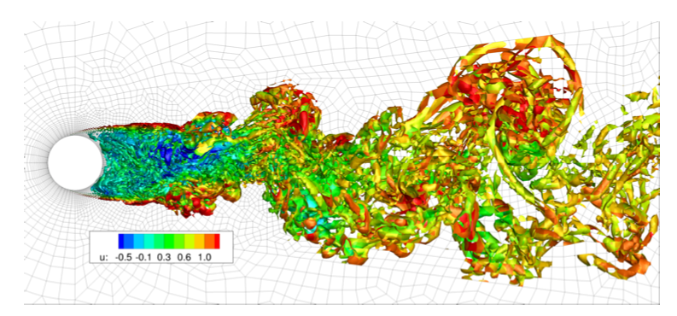
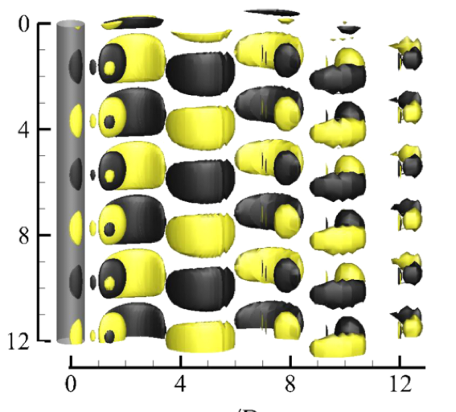
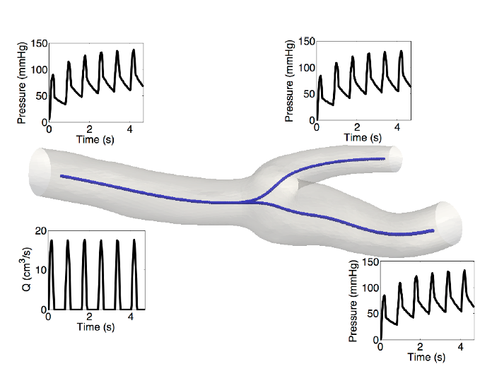
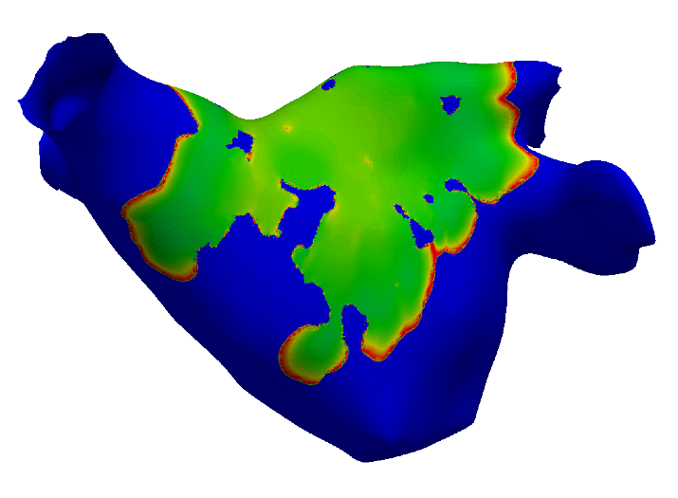
Framework design
ADR
IncNavierStokes
CompressibleFlow
PulseWave
ShallowWater
CardiacEP
…
~/nektar/solvers

Slide 4
Framework design
ADR
IncNavierStokes
CompressibleFlow
PulseWave
ShallowWater
CardiacEP
…
SolverUtils
EquationSystem
Advection
Diffusion
UnsteadySystem
AdvectionSystem
AcousticsSystem
IncNavierStokes
CompressibleFlowSystem
~/nektar/library/SolverUtils

Slide 5
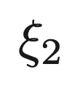
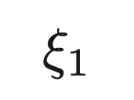
Framework design
ADR
IncNavierStokes
CompressibleFlow
PulseWave
ShallowWater
CardiacEP
…
SolverUtils
Core Nektar++ libraries
StdRegions
SpatialDomains
LocalRegions
MultiRegions
D
C
A
B
StdRegions
~/nektar/library/StdRegions

Slide 6
Framework design
ADR
IncNavierStokes
CompressibleFlow
PulseWave
ShallowWater
CardiacEP
…
SolverUtils
Core Nektar++ libraries
StdRegions
SpatialDomains
LocalRegions
MultiRegions
D
C
A
B
SpatialDomains
StdRegions
~/nektar/library/SpatialDomains

Slide 7
Framework design
ADR
IncNavierStokes
CompressibleFlow
PulseWave
ShallowWater
CardiacEP
…
SolverUtils
Core Nektar++ libraries
StdRegions
SpatialDomains
LocalRegions
MultiRegions
D
C
B
C
C
A
B
D
A
D
SpatialDomains
StdRegions
~/nektar/library/LocalRegions
LocalRegions

Slide 8
Framework design
ADR
IncNavierStokes
CompressibleFlow
PulseWave
ShallowWater
CardiacEP
…
SolverUtils
Core Nektar++ libraries
StdRegions
SpatialDomains
LocalRegions
MultiRegions
D
C
B
B
C
MultiRegions
C
A
B
A
D
A
D
SpatialDomains
StdRegions
~/nektar/library/MultiRegions
LocalRegions

Slide 9
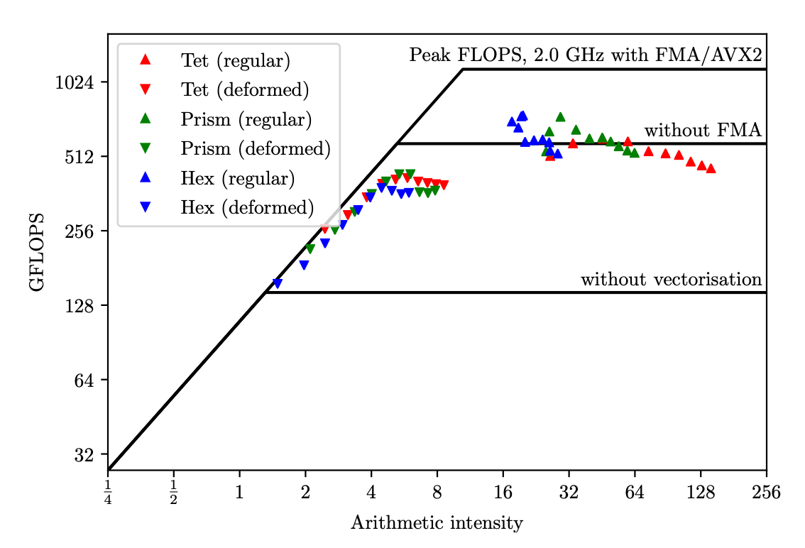
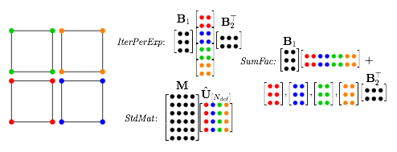
Framework design
ADR
IncNavierStokes
CompressibleFlow
PulseWave
ShallowWater
CardiacEP
…
SolverUtils
Core Nektar++ libraries
StdRegions
SpatialDomains
LocalRegions
MultiRegions
Collections
MatrixFreeOps
with AVX2
increasing P
Memory Bandwidth
limited
Floating point
limited
~/nektar/library/Collections
~/nektar/library/MatrixFreeOps

Slide 10
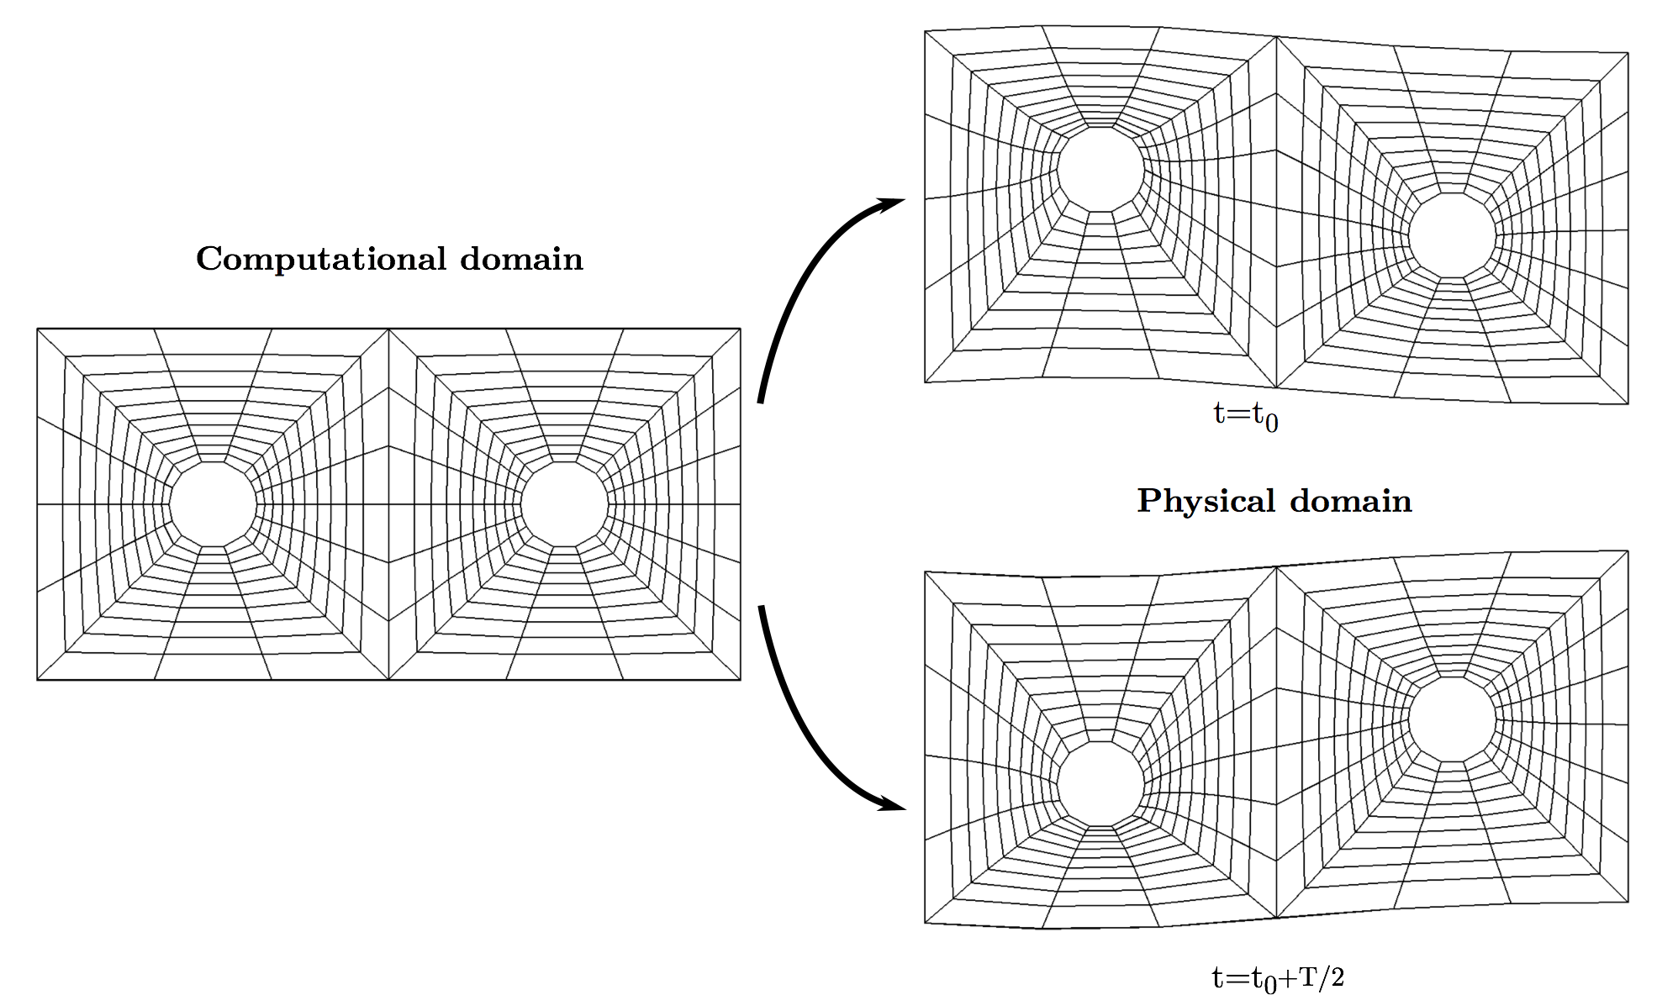
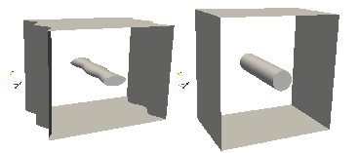
Framework design
ADR
IncNavierStokes
CompressibleFlow
PulseWave
ShallowWater
CardiacEP
…
SolverUtils
Core Nektar++ libraries
StdRegions
SpatialDomains
LocalRegions
MultiRegions
Collections
MatrixFreeOps
GlobalMapping
~/nektar/library/GlobalMapping

Slide 11
Framework design
ADR
IncNavierStokes
CompressibleFlow
PulseWave
ShallowWater
CardiacEP
…
SolverUtils
Core Nektar++ libraries
StdRegions
SpatialDomains
LocalRegions
MultiRegions
Collections
MatrixFreeOps
GlobalMapping
NekMesh
FieldUtils
Input
Process
Process
Output
Nektar++
CAD
Gmsh
Tecplot/Star
High-order smoothing
Boundary refinement
Nektar++
Gmsh
VTK (linear)
~/nektar/library/NekMesh
~/nektar/library/FieldUtils
~/nektar/utilities/NekMesh
~/nektar/utilities/FieldConvert

Slide 12
Framework design
ADR
IncNavierStokes
CompressibleFlow
PulseWave
ShallowWater
CardiacEP
…
SolverUtils
Core Nektar++ libraries
StdRegions
SpatialDomains
LocalRegions
MultiRegions
Collections
MatrixFreeOps
GlobalMapping
NekMesh
FieldUtils
LibUtilities
Quadrature, bases, partitioning, input/output, linear algebra, interpreter, FFT, ...
~/nektar/library/LibUtilities

Slide 13
Framework design
ADR
IncNavierStokes
CompressibleFlow
PulseWave
ShallowWater
CardiacEP
…
SolverUtils
Core Nektar++ libraries
StdRegions
SpatialDomains
LocalRegions
MultiRegions
Collections
MatrixFreeOps
GlobalMapping
NekMesh
FieldUtils
LibUtilities
Quadrature, bases, partitioning, input/output, linear algebra, interpreter, FFT, ...
Boost
Scotch
TinyXML
Gslib
FFTW
VTK
PETSc
ARPACK
Metis
~/nektar/library/LibUtilities

