Slide 1
Nektar++ Solvers

Slide 2
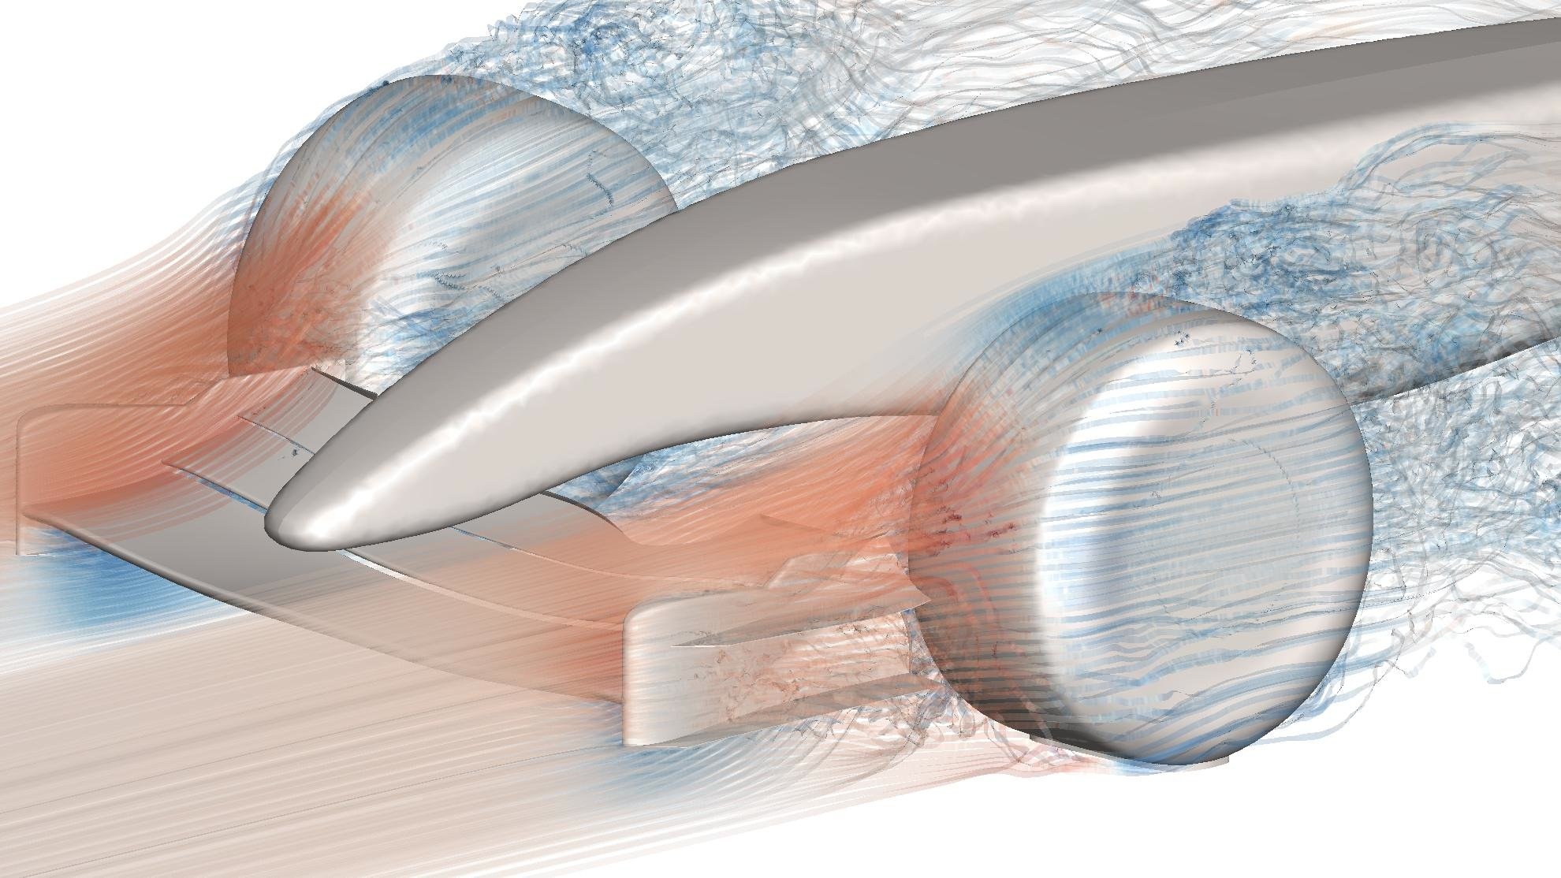
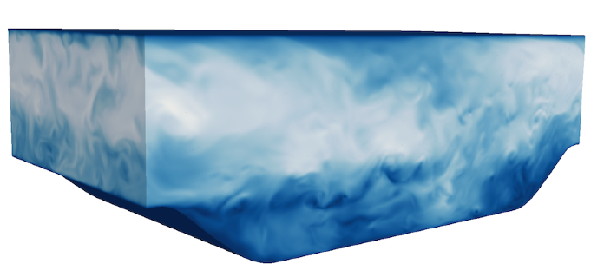
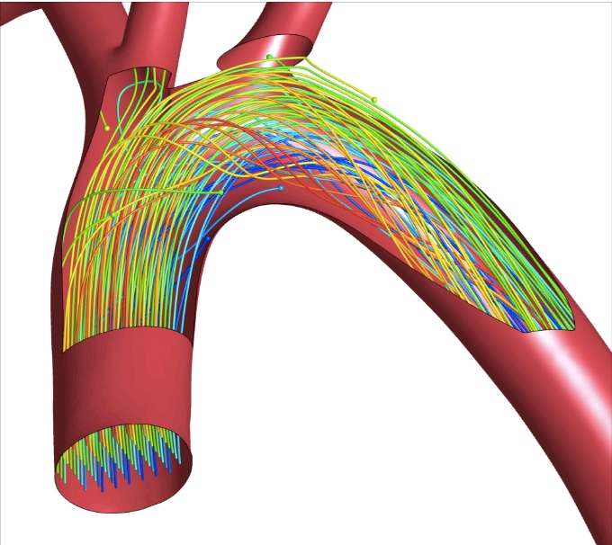
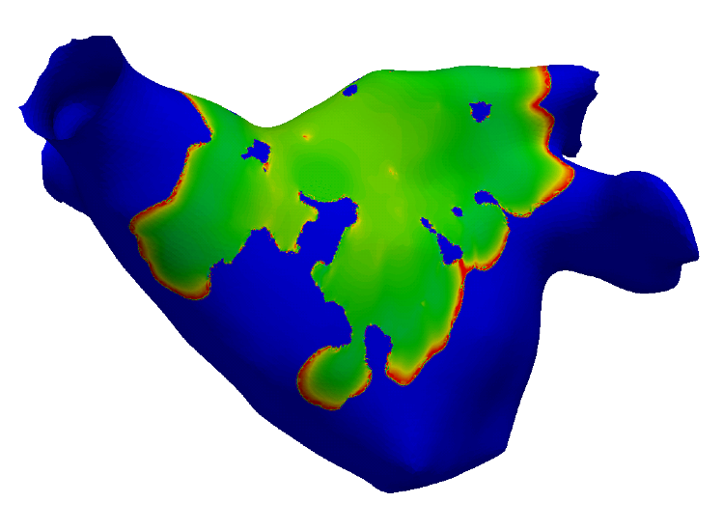
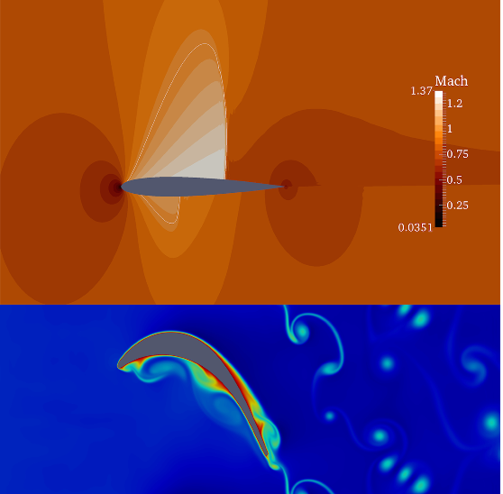
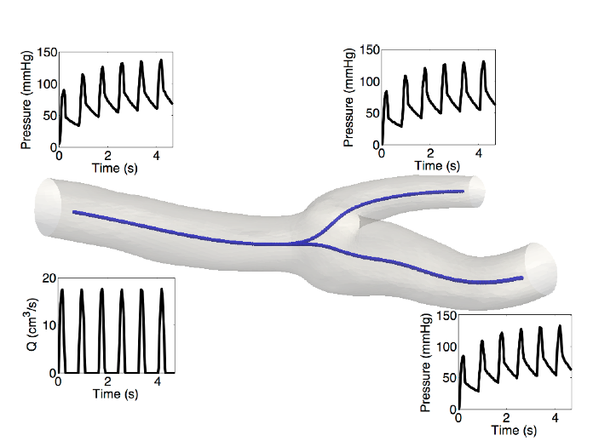
Nektar++: www.nektar.info
Notes:
Alway always complaining to me there are “too many CFD codes” as compared to the number of codes in other fields.
Although I do probably agree there are too many codes there are also many different forms of fluid mechanics/aerodynamics which some different mathematical properties. - these represent the range of my own interest:
Many forms for fluid mechanics. Your beating heart, breathing and hearing me talk all represent different types of fluid mechanics.
Fusions modelling
Riser pipe image rather than stability.
Points about many forms of fluid mechanics and so many forms of Cfd solvers.
Wide application of fluid dynamics
- fluid takes many forms: in this room have acoustics, cardiovascular and respiratory flows, heating system.
- leads to wide range of codes
- use spectrum?

