Slide 1
Nektar++ History

Slide 2
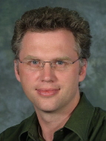
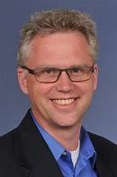
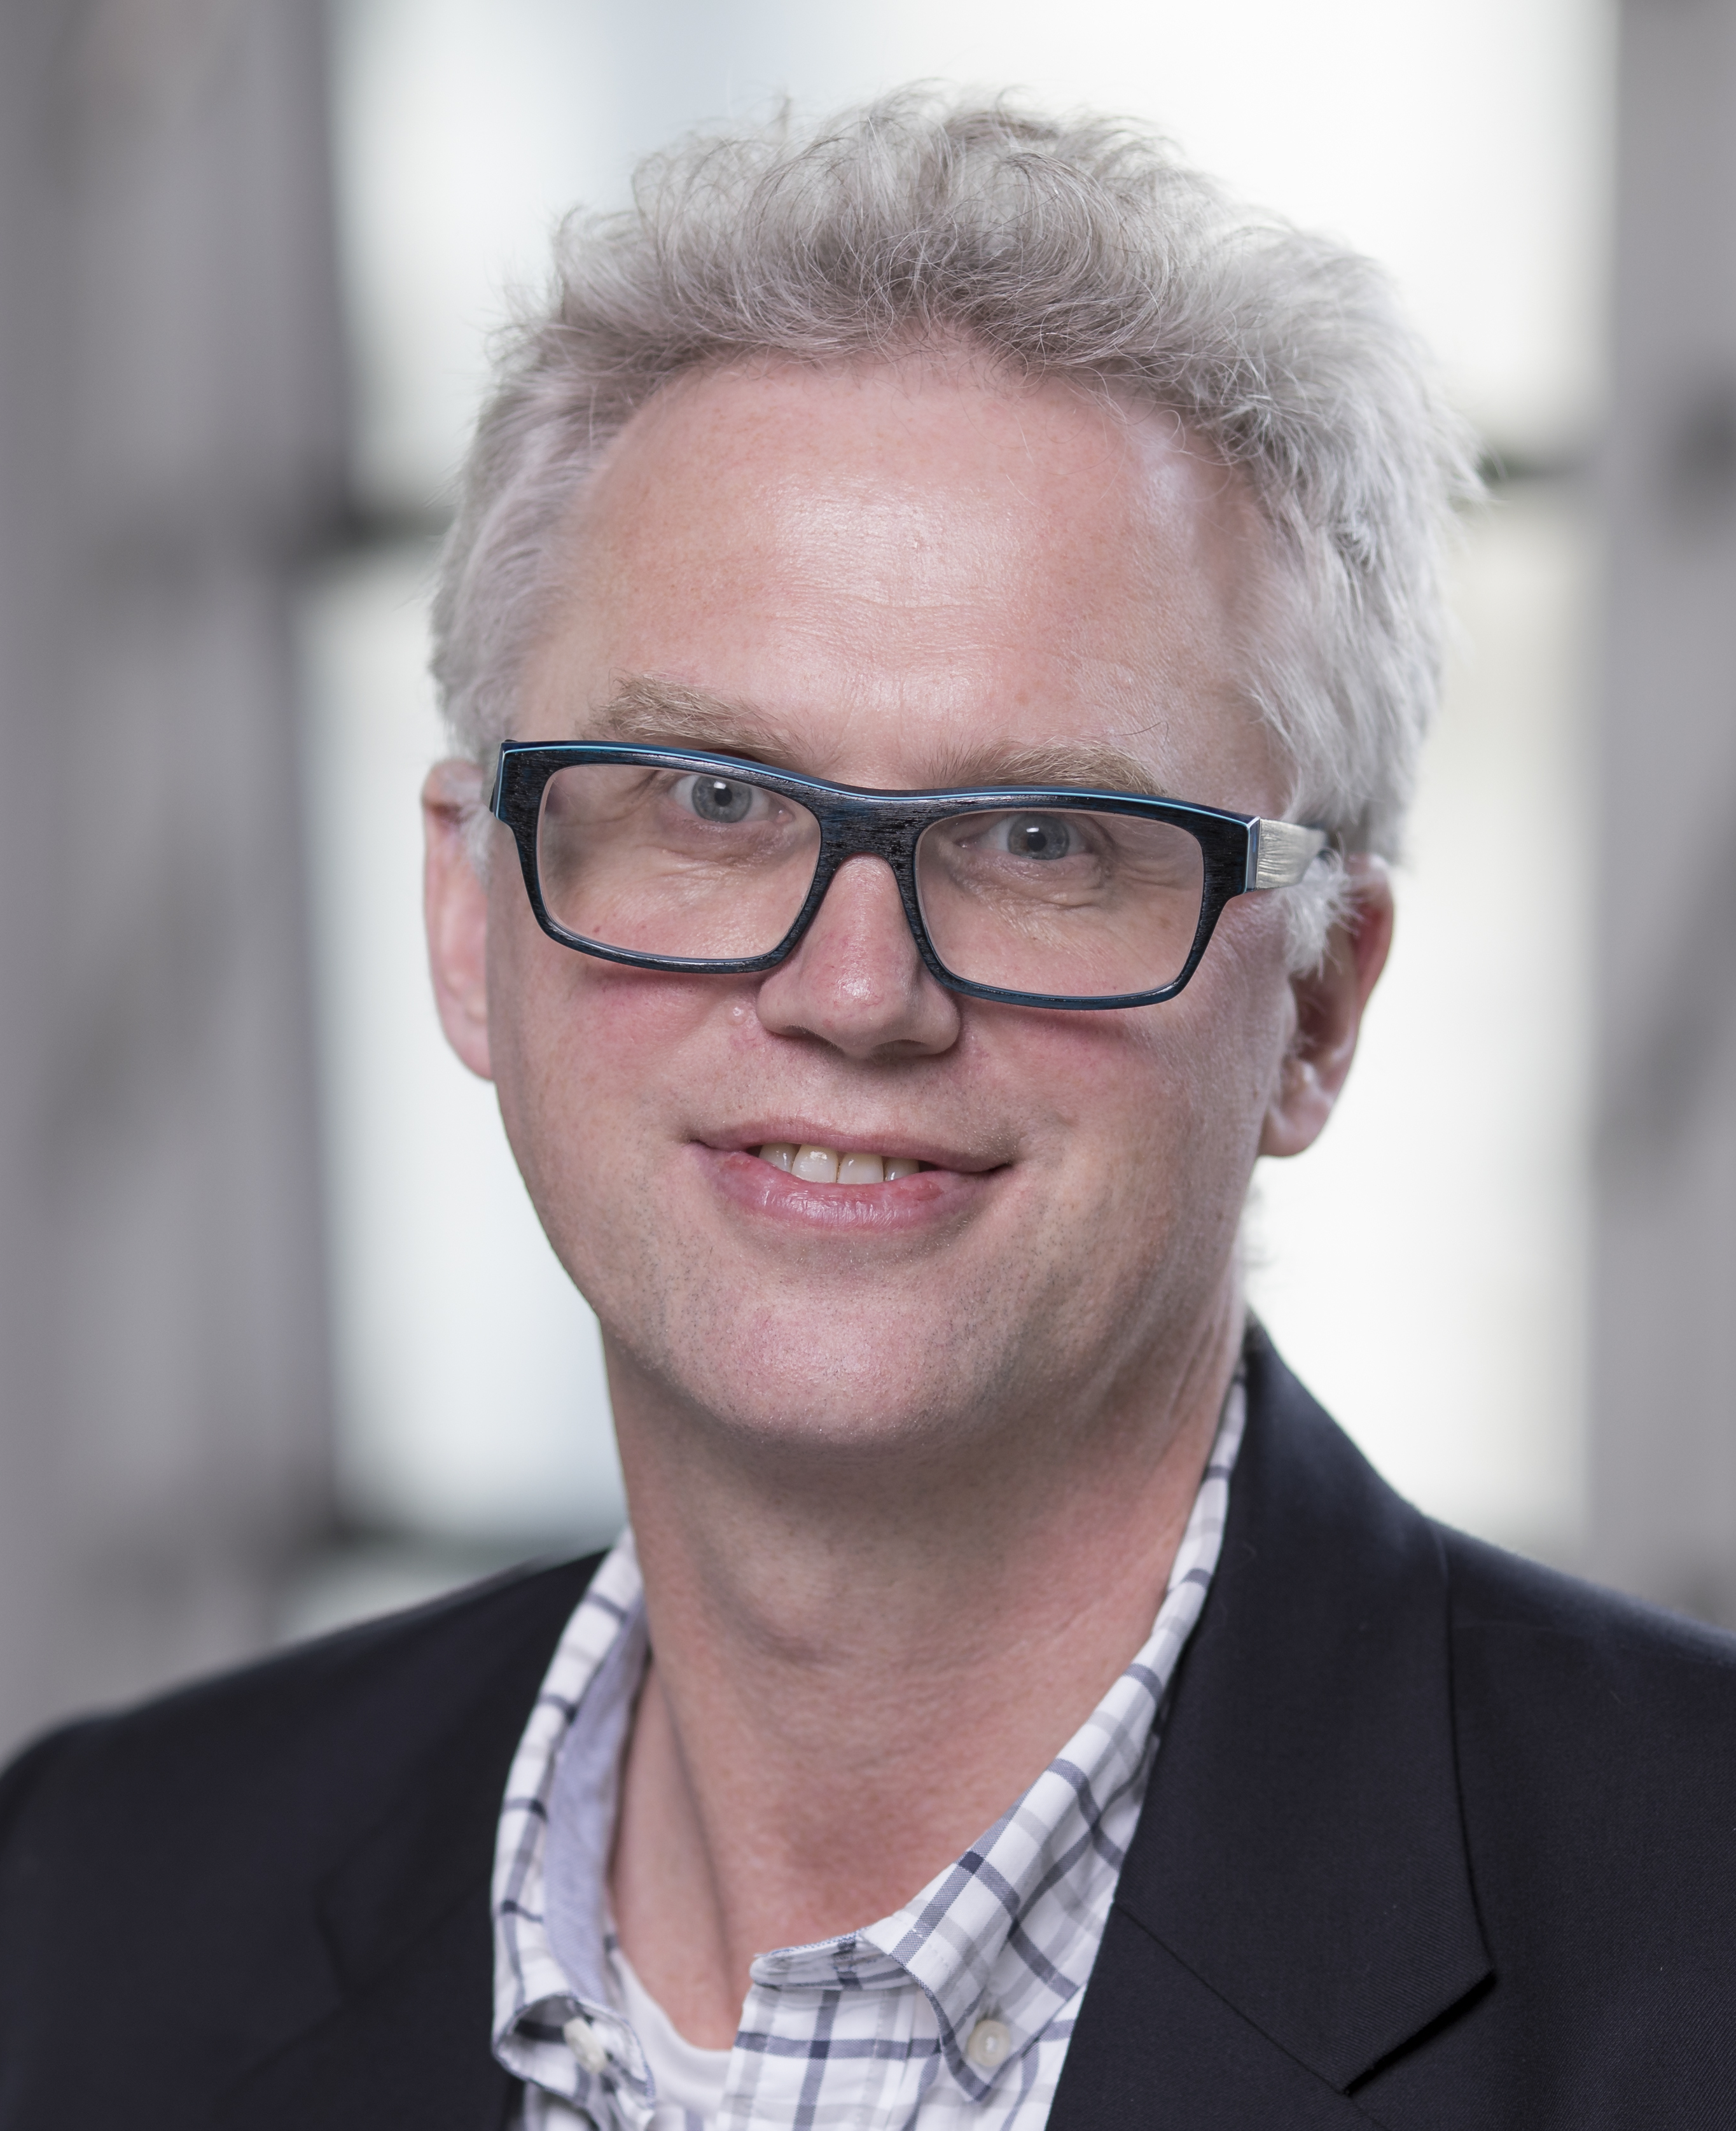
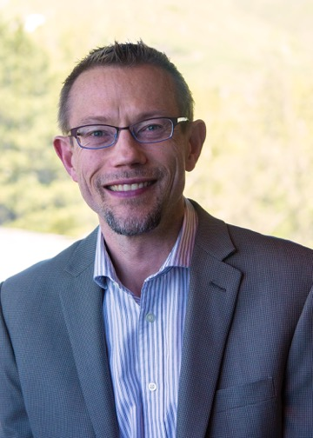
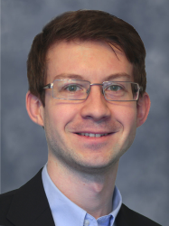
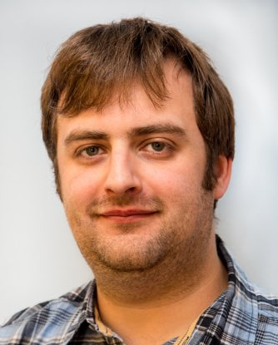
Spencer Sherwin
1992-95
1999
2003-05
2009
2021
Mike Kirby
Chris Cantwell
Dave Moxey
Theory, First Implementation, PhD Ware
Redesign, Wider Application

